Slide 1
MEC 402 Casting, Welding and Forming
Dr. Arjyajyoti Goswami
arjyajyoti.Goswami@me.nitdgp.ac.in
+91-9953167384

Slide 2
Welding Arc and SMAW:
What is Arc ?
Arc initiation methods
Arc characteristics
Types of power sources
Gradually drooping
Steeply drooping
Flat
Rising
DC vs AC power source
SMAW revisited
Electrode coatings

Slide 3
Why study about it
To understand the mechanism of the Welding Arc, since it is an integral part of Arc Welding processes, which is one of the most common form of welding.
Understanding the welding arc allows us to manipulate it to our advantage.

Slide 4
Welding Arc
It is an electric discharge between 2 electrodes which takes place through an electrically conducting hot ionized gas.
The discharge is initiated by an avalanche of electrons emitted from the hot cathode and maintained by the thermal ionization of the hot gas.
Welding arc has high current (upto 2000A ) and low voltage (10-50V).
The electrons emitted from the cathode passes through the hot ionized gas and merges into the anode, where they get condensed and are absorbed.

Slide 5
Arc formation mechanism

Slide 6
Heat of the arc:
The potential difference (voltage) applied across the terminals causes the electrons to go up at higher energy levels.
During ejection from the electrode tip these electrons cause ionization of the air molecules, releasing heat of ionization.
Also in this process, they lose some of the energy which they obtained from the applied voltage.
These two energies are the source of heat of the arc which fulfills the first and the most important requirement of energy for welding.
The process of ionization of air molecules and release of energy takes place millions of time in a second throughout the duration for which the arc is struck.

Slide 7
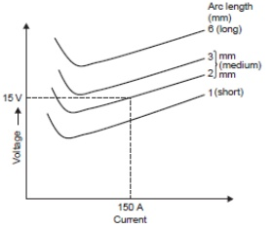
Arc Characteristics
It is a graphical relationship between the voltage across the arc and the arc current. Obtained by plotting the voltage of a welding arc at varying arc lengths
Region 1 : low to medium current
As current increases arc temperature and hence the electrical conductivity of the arc increases hence less voltage is required to send the electrons from one electrode to another.
With increase in electrical conductivity of the arc the required current is able to flow with less voltage drop hence with increase in arc current the arc voltage decreases.
Region 1
Region 2
The curve starts from Y axis, i.e. initially very high voltage is needed to be applied for the current to start flowing

Slide 8
Region 2 : medium to high current
With increase in arc current beyond a point the total arc length (i.e. apparent arc length + penetration) increases, due to increased penetration.
Also at higher currents the arc column takes on a spherical shape increasing the path through which the electron has to be transferred.
Due to these 2 reasons with increase in arc current beyond a certain point the necessary arc voltage increases.
Region 1
Region 2

Slide 9
Arc Initiation : Needed because the arc current needs an ionized passage for flowing across the gap.
Arc initiation can be done through following methods:
1. Application of high voltage across the electrode gap (10,000 Volts, at 50Hz applied for few milli seconds, just to start the arc. Can not be applied for longer time. Suited for GTAW).
2. Short circuiting of the electrodes (just touching or scratching the workpiece with the electrode. Heavy current starts flowing through the short circuit, upon withdrawal the elctrons already in motion comes out of the electrode tip and arc is formed)
3. Other methods (putting steel wool or graphite between the electrode and the workpiece, rest is same as short circuiting)

Slide 10
Welding power sources

Slide 11
Welding power source is the apparatus needed to provide suitable current and voltage for a particular welding process.
Requirements of a welding power source:
The no load or the Open Circuit Voltage (OCV) should be high enough to strike an arc but not so high so as to endanger the operator.
The voltage of the arc should adjust itself rapidly with change in arc length. This is especially required in cases of manual welding.
The power of the welding power source should be sufficient to provide the required welding current.
The short circuit current (Isc) must be within safe limits of the instrument wiring. If the short circuit current is too high it can cause damage to the wiring of the power source

Slide 12
Static vs Dynamic characteristics
Static characteristics
Dynamic characteristics
A curve showing the output current versus the output voltage for a given power source constitutes its Static Characteristics.
Describes the instantaneous variations occurring over a short interval of time (short interval = milli-second).
Utilized mainly in research activities.
The static V-I characteristic of a power source is provided by the manufacturer.
It is the basis on which the purchasing of a particular type of power source is made.

Slide 13
4 basic types of welding power sources
The types are defined by the nature of the static characteristic curves.
External static V-I characteristic is a curve relating the voltage of the source to the welding current.
It is obtained by measuring the output voltage and current while statically loading it with pure resistive load which is varied from minimum to the maximum load condition

Slide 14
Gradually Drooping Characteristics (Constant Current)
The arc formed from this power source is called ‘self-adjusting’ or ‘self-controlling’ arc.
This type of suitable for manual welding processes because even with large change in arc length (hence arc voltage) the welding current does not get much affected.
Thus the human error is compensated and the energy input remains constant throughout.

Slide 15
Steeply Drooping Characteristics (True Constant Current)
It has the highest Open Circuit Voltage and lowest short circuit current.
With change in arc length the change in the current is very little.
This type of welding current is best suited for SMAW that is manual metal arc welding with coated electrodes.
Also a high open circuit voltage ensures easy initiation and maintenance of the welding arc.

Slide 17
Flat Characteristics (Constant Voltage)
Arc obtained from such kind of power source is called as ‘self-regulating’ arc.
All welding power sources with flat V-I characteristics almost invariably use reverse polarity (DCEP).
Mostly used for semi-automatic welding processes where the wire feed is through motors, like GMAW, SAW etc.

Slide 21
Rising Characteristics
In such power source with the increase in voltage there is an increase in current.
Used in fully automatic welding processes like Robotic Welding.
Semi-Automatic processes have some manual intervention in their functioning while Automatic processes just needs to be started, after that it can complete on its own without further manual intervention.

Slide 22
Power Factor: Ratio of power used in welding to Power drawn from supply. The power unused for welding goes in maintaining the auxiliary processes. Power factor should be as high as possible.
Duty Cycle: Ratio of Arc time to Total Time based on 10 minutes averaging period.
Duty cycle should be as high as possible.
If power factor and duty cycle are high then the process can be said to be working satisfactorily.

Slide 23
AC vs DC

Slide 24




Google.com/black_ice
Google.com/drake_meme_
Google.com/tesla_edison

Slide 25
Criteria | DC | AC
Ease of arc starting | Easy | Difficult
Ease of arc maintenance | Easy | Difficult
Stability at low currents | Good | Poor
Stability at low arc lengths | Good | Poor
Electrode used | Any | With special coatings of titania, so that arc starting and maintenance is made easier

Slide 26
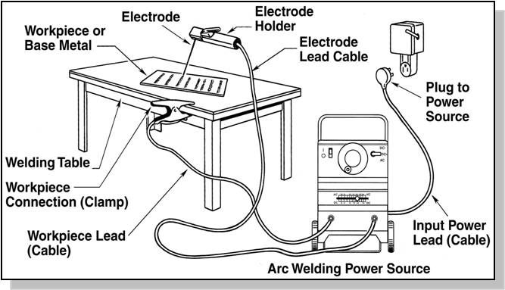
SMAW
https://www.pinterest.com/pin/454793262354211901/

Slide 27
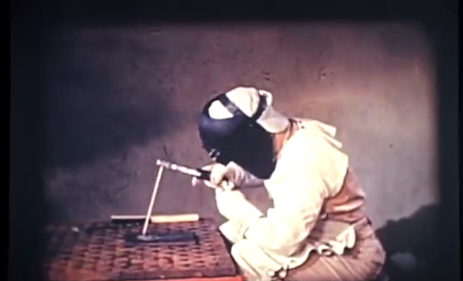
https://www.youtube.com/watch?v=TeBX6cKKHWY&ab_channel=EdisonTechCenter

